Slide 1
Best Pizza Eatery to recommend for a first time tourist to USA
Anuradha B

Slide 2
Business Requirement
Recommend best places to have pizza for a first time tourist to USA.

Slide 3
Studied Cities:
5 cities for Analysis:
New York,NY,
San Francisco, CA,
Jersey City, NJ,
Boston, MA and
Chicago,IL.

Slide 4
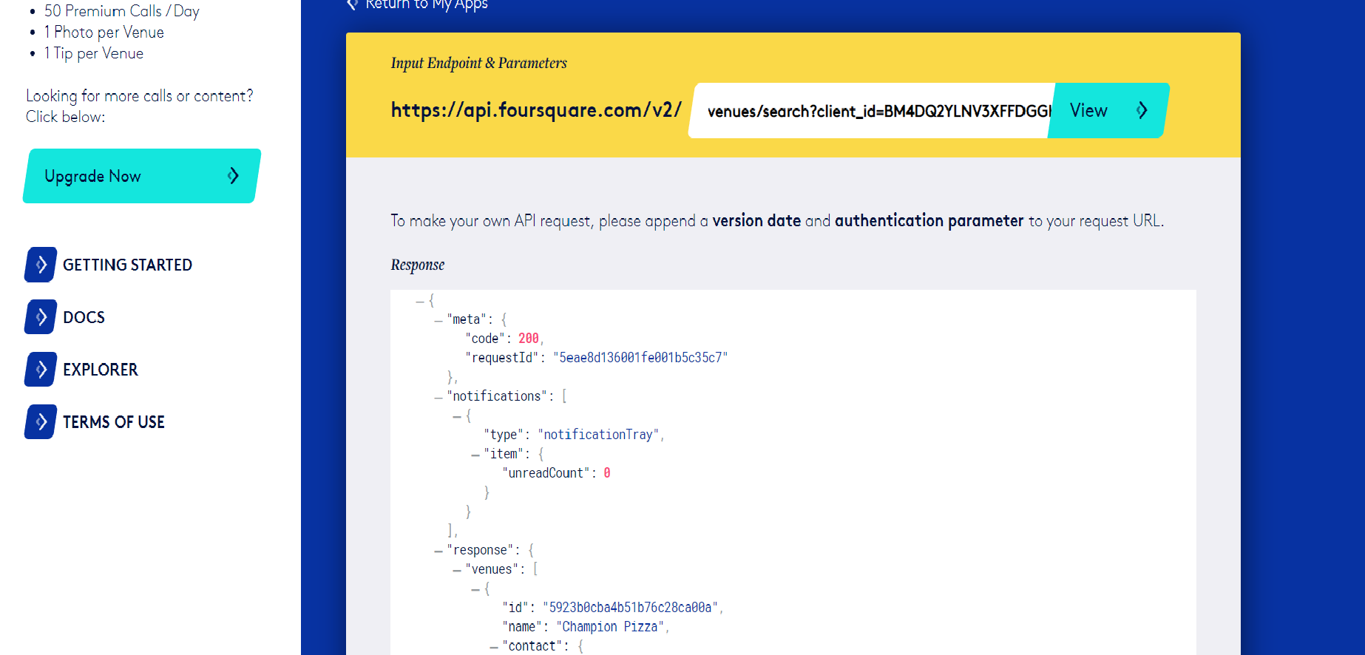
Data Collection
FOUR SQUARE API

Slide 6
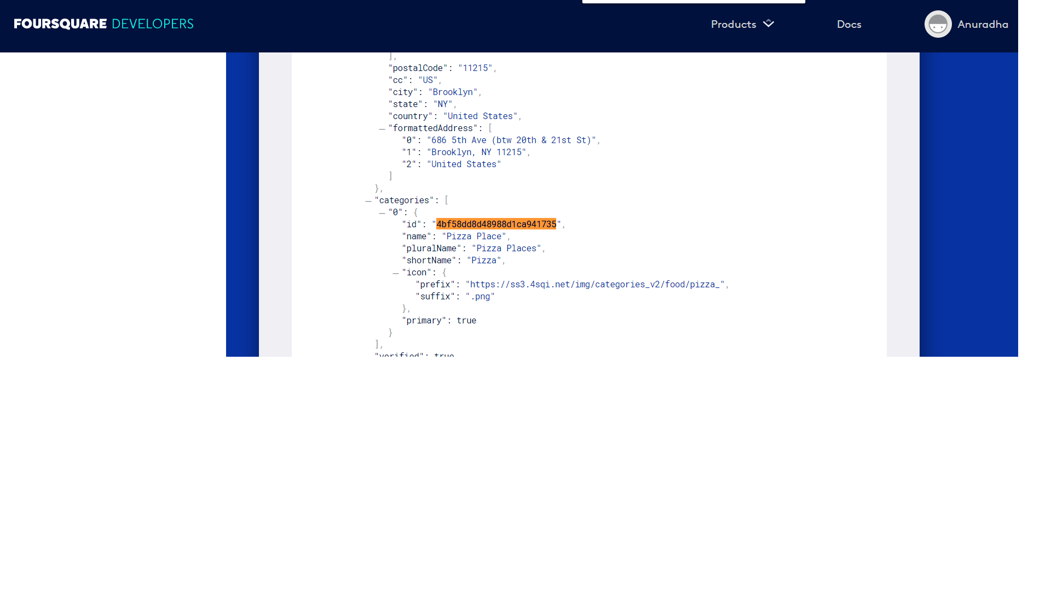
Pizza Category ID Sample Query Used- https://api.foursquare.com/v2/venues/explore?&client_id= BM4DQ2YLNV3XFFDGGKTXJQAUM115RV4XHAXWU2BIXACJ2I40&client_secret= POAFJQCYLDFOJ1Q4I4JKG3WJ0TZ04F2IZ3YHP5SH1MIZOVRB&v=20180605&New York, NY&limit=100&categoryId=4bf58dd8d48988d1ca941735

Slide 7
Method
Calculate center coordinate of the venues to get the mean longitude and latitude values
Calculate the mean of the Euclidean distance from each venue to the mean coordinates
Lowest Distance is my target point

Slide 8
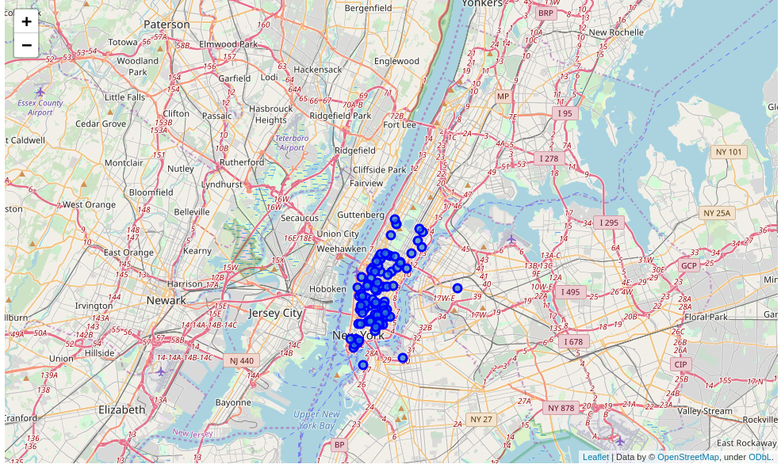
View of the result Maps- NY

Slide 9
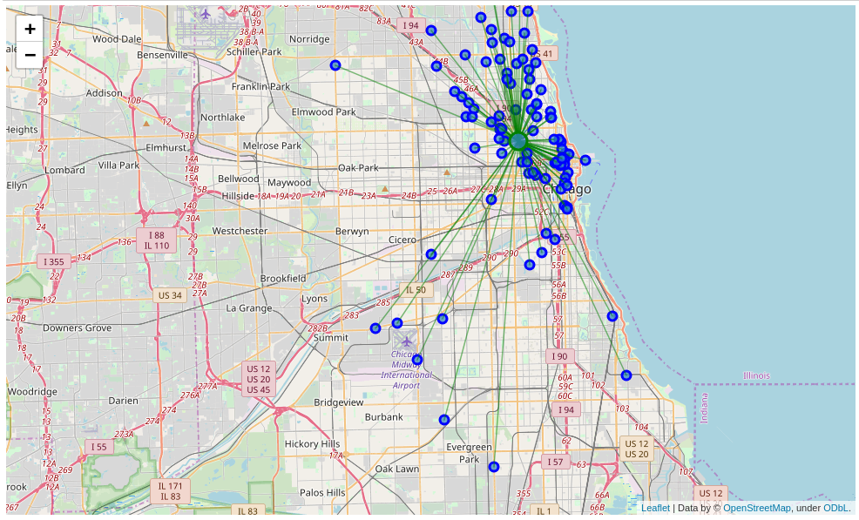
Chicago Map with density points

Slide 10
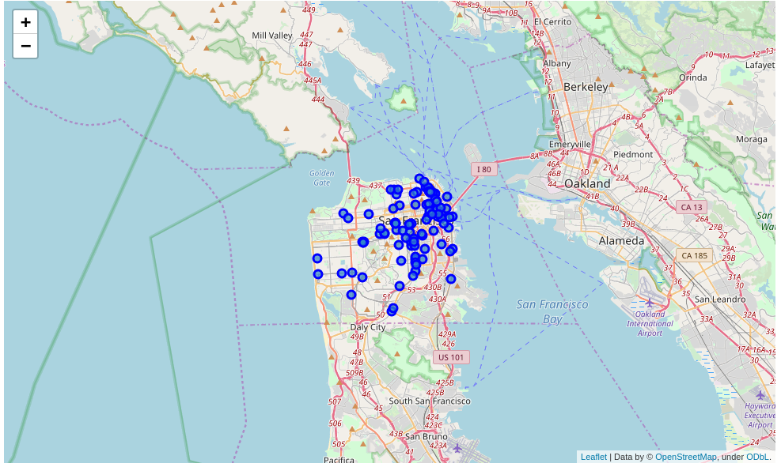
SFO Map

Slide 11
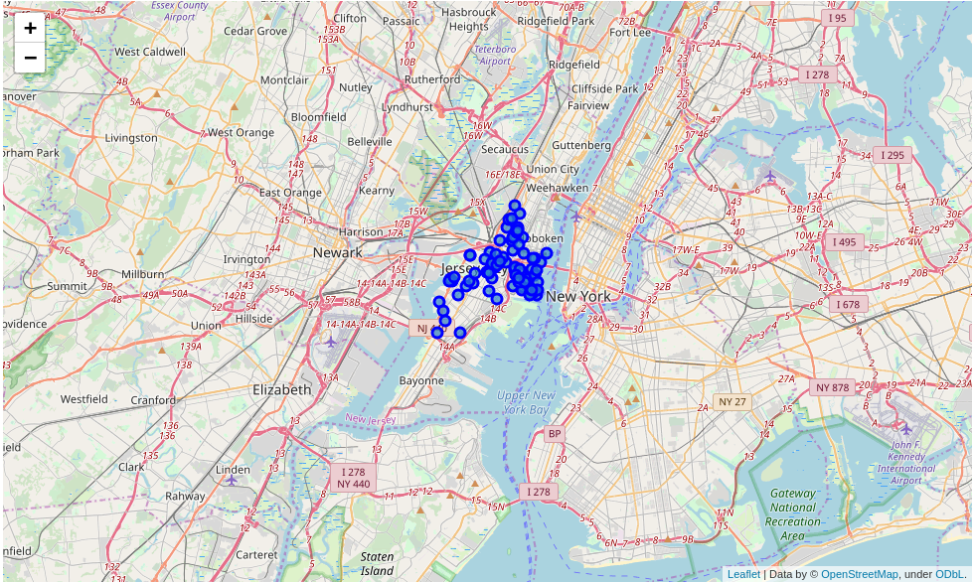
Jersey City

Slide 12
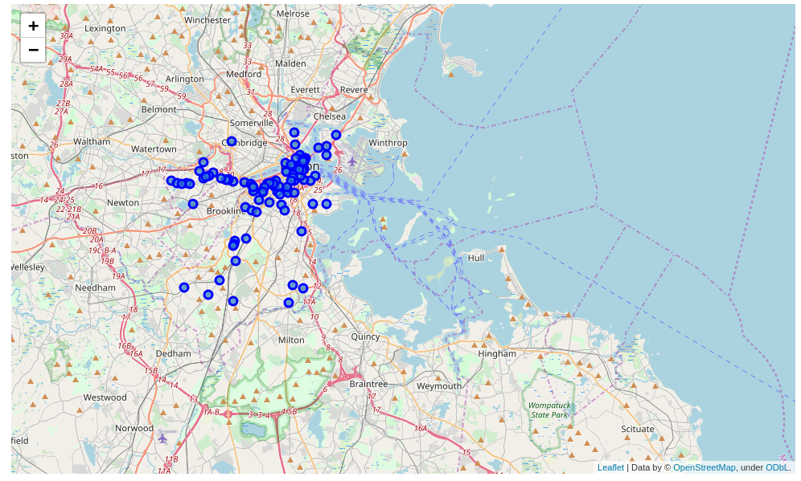
Boston

Slide 13


Conclusion
The best place to enjoy a pizza is
1)Jersey City [if travel is not an issue],
2)Next in line comes New York

Slide 14
Thank You

